Slide 1
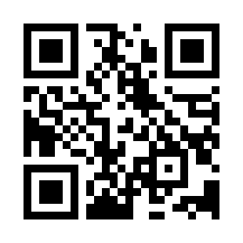

Introduction to Software Design Quiz
https://bit.ly/3LnVhWR

